Slide 1
Neuromuscular Sensing for Control of Robotic Exoskeletons
Chad G. Rose
Avinash Baskaran

Slide 2
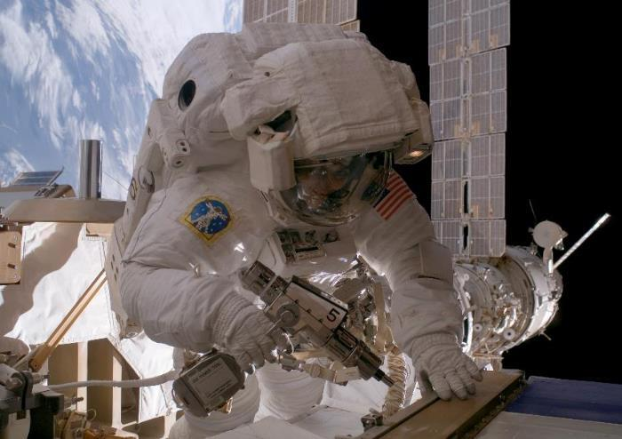
Motivation
Astronauts experience hand fatigue and overuse injury in EVA settings due to the stiffness of EVA gloves ^{[1]}.
Fig 1. Astronaut experiences hand muscle fatigue while operating a high-torque drill during EVA, leading her to lose control of the drill, which strikes and damages a nearby electrical connector. (figure reproduced from [2])

Slide 3
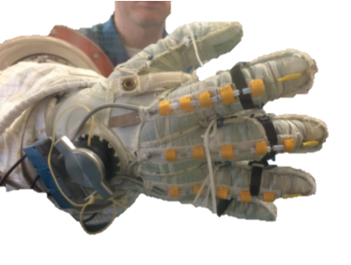
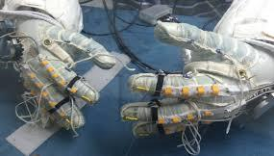
Motivation
Robotic exoskeletons for the hand have been proposed to help reduce astronaut neuromuscular effort while wearing stiff EVA gloves ^{[3]}.
Fig 2. NASA’s Space-suit RoboGlove (SSRG) is aa space-suit compatible robotic exoskeleton that has been explored for astronaut EVA assistance (figures reproduced from [3])

Slide 4
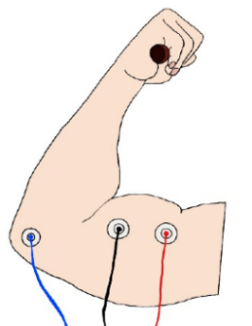
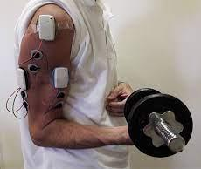
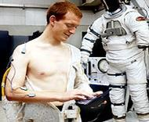
Motivation
Surface electromyography (sEMG)
Muscle electrical activity detectable from skin surface
Leads kinematic output, and can be worn comfortably under EVA suits.
Commercial EMG systems are too bulky, expensive, and uncomfortable to be used in EVA settings
[4]
Fig 3. Muscle activity can be detected by measuring electrical potentials at the skin surface

Slide 5
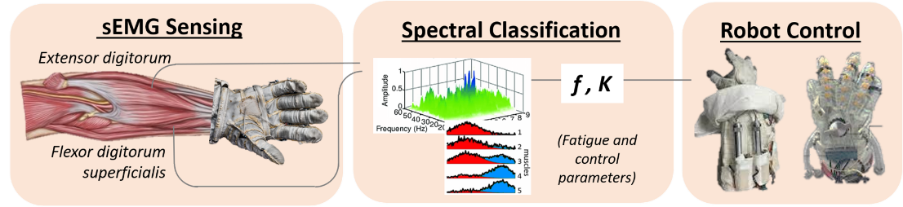
Scope of Work
A novel EVA-compatible sEMG platform for control of robotic exoskeletons.

Slide 6
Scope of Work
Interdisciplinary collaboration
Sensing Design and Implementation
Sierra Eady

Slide 7
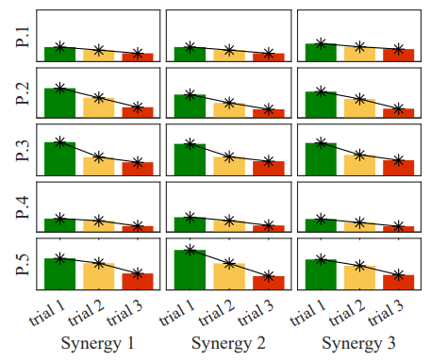
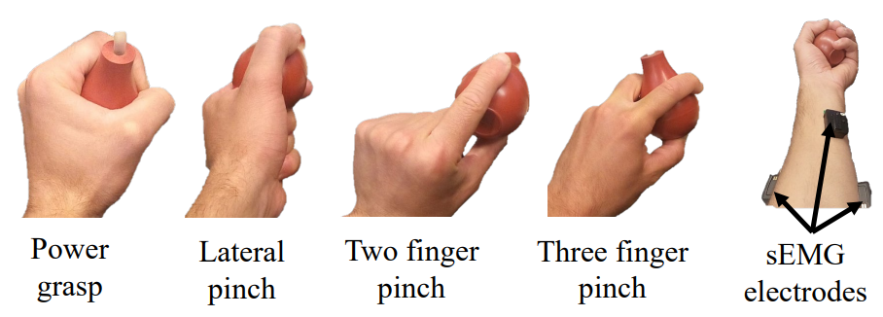
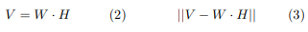
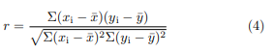
Task 1: Software for Fatigue Detection
Software to factor and analyze sEMG signals.
Validated in a pilot study with human participants
(1)
(2)
(3)
Fig 5. An experimental trial was carried out in which participants performed ‘power grasp’ (ie. full handed squeeze) using an instrumented hand dynamometer with sEMG electrodes placed on the forearm.
Notes:
Non-negative matrix factorization (eqn 1.) satisfying the minimization of the Frobenius norm (eqn 2.) was carried out, and the results were weighted with Pearson correlation (eqn 3.). The study showed that the software method successfully detected neuromuscular fatigue from sEMG signals.

Slide 8
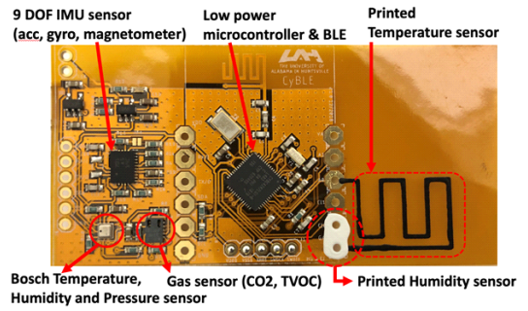
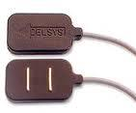
Task 2: Design and Fabricate EVA-compatible sEMG electrodes
In collaboration with MSFC, we hope to develop and obtain a novel EVA-compatible sEMG sensor package, featuring:
Silver (Ag), or silver-silver chloride (Ag-AgCl) electrode clusters
Multi-stage analog (RC) and digital filtering
Low power microcontroller and radio communication
[6]
[7]
Fig 6. Left: Sensor design inspired by flexible, EVA-compatible bio-sensor developed by Jovanov et al. Right: Consumer-grade sEMG electrode cluster, illustrating desired sensor functionality (figures reproduced from [6,7])

Slide 9
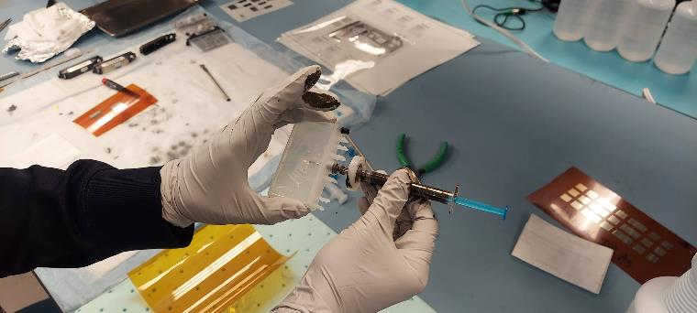
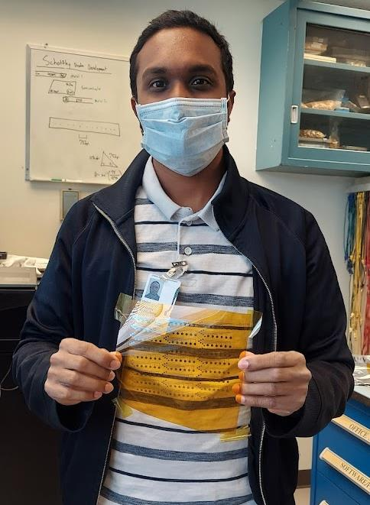
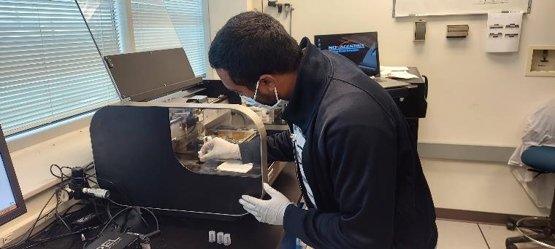
ASGC Fellowship Research

Slide 10
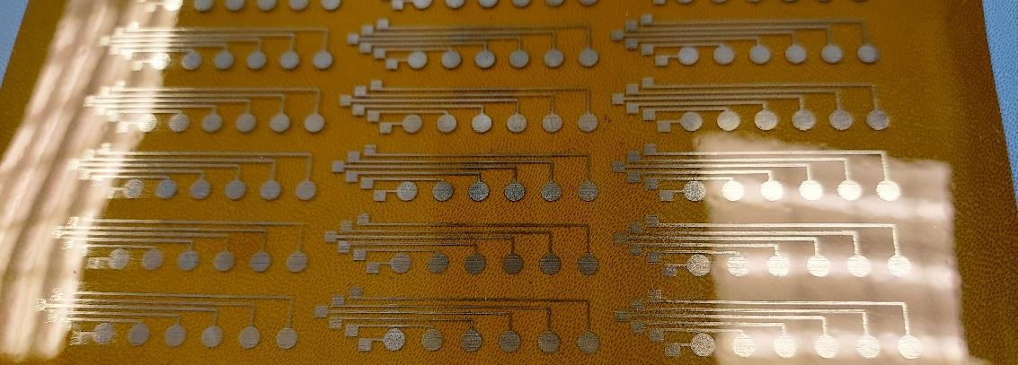
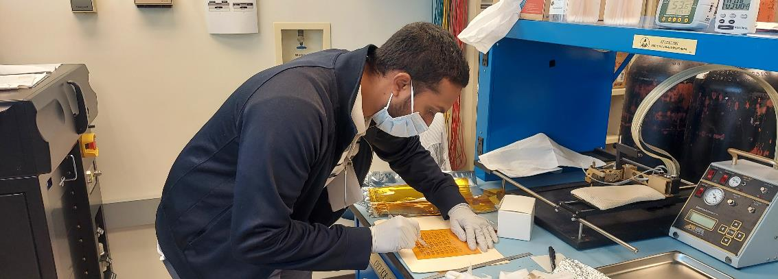
ASGC Fellowship Research

Slide 11
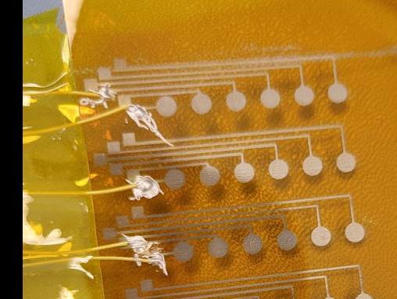
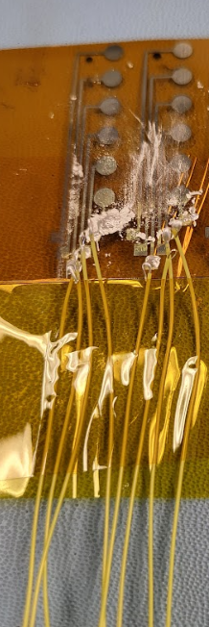
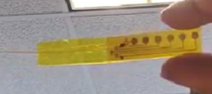
ASGC Fellowship Research

Slide 12
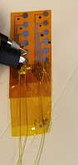
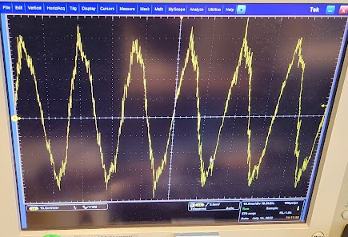
Experiment 1
Assess signal integrity through the sensor
Notes:
with sub micro-volt noise

Slide 13
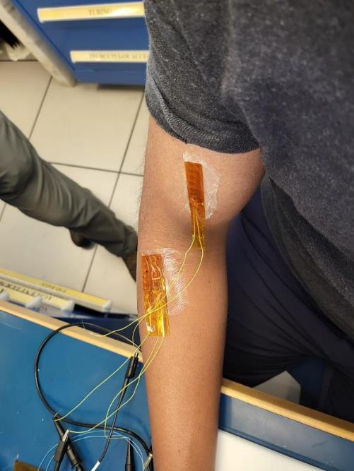
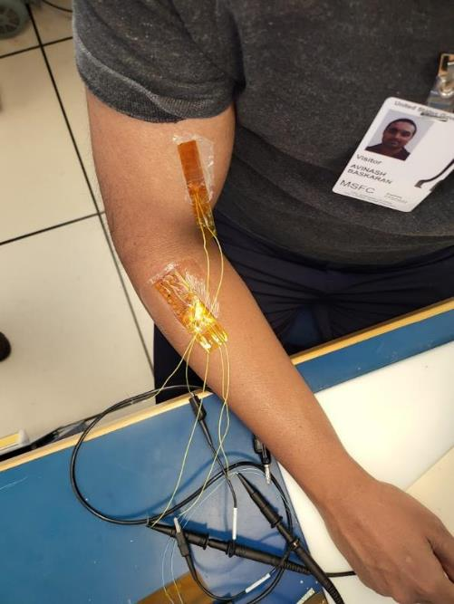
Experiment 2
Measure and observe muscle activity

Slide 14
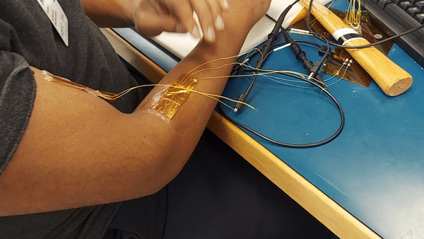
Experiment 2

Slide 15
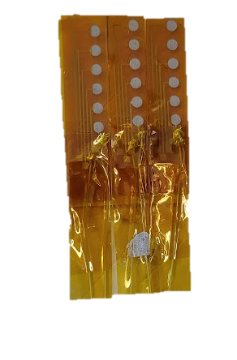
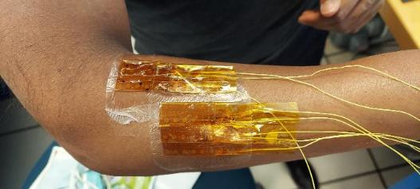
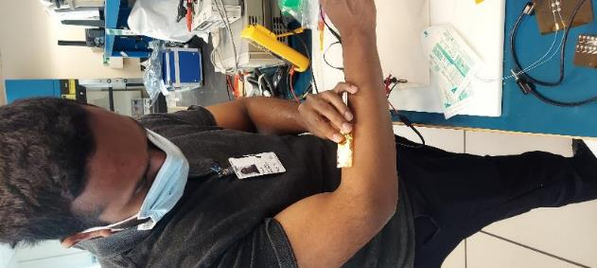
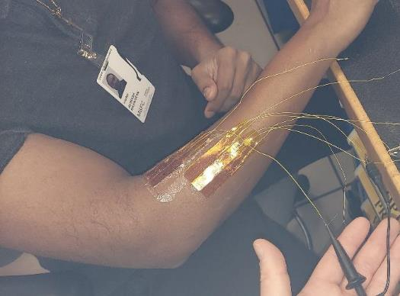
Experiment 3
Observe spatiotemporal features in muscle activity

Slide 16
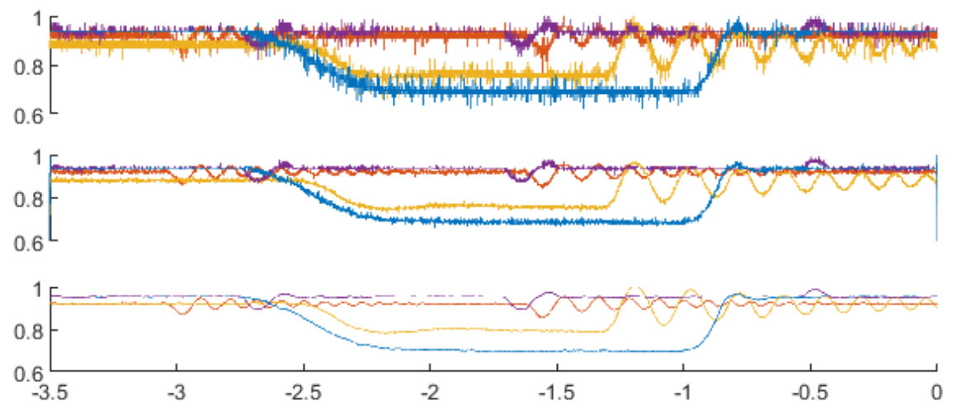
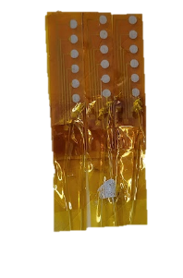
Experiment 3
Raw EMG data
Lowpass (800 Hz)
1st order Savitzky-Golay convolutional filter
GND
GND

Slide 17
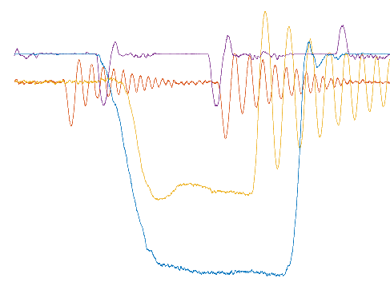
Experiment 3
Motor unit ‘action potential’ (MUAP) is an electrical wave sent to the muscle, causing it to contract.
We observe delays and amplitude changes in accordance with the positions of the electrodes and expected MUAP wave.
GND

Slide 18
Tasks Accomplished
Fabricated and validated flexible electrodes
Learned and practiced inkjet-based electronics printing and biosensor design-for-manufacturing
Increased familiarity with spatiotemporal filtering of non-stationary bio-signals
Developed upon a novel research thrust
Ensured sustainable two-way knowledge transfer between WeBR Lab and the printed electronics group
Met some great mentors

Slide 19
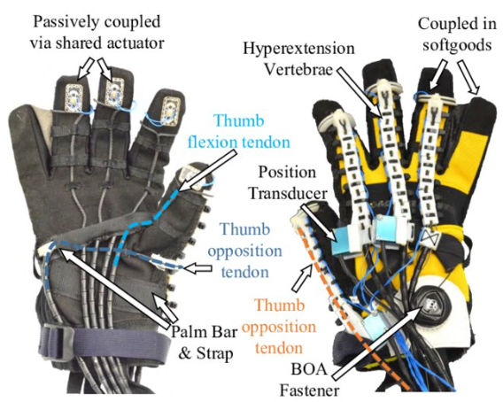
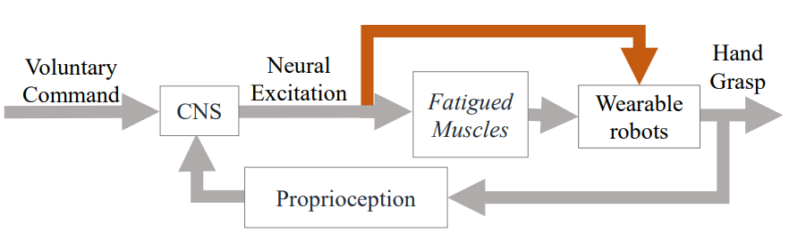
Task 3: Implementation in Robot Control
The sEMG sensing system developed in tasks 1 and 2 will be used to control the SeptaPose Assistive and Rehabilitative (SPAR) robotic glove in a validation experiment with human participants
sEMG sensing
[13]
Fig 5. Left: the SeptaPose Assistive and Rehabilitative (SPAR) robotic glove will be controlled via the paradigm shown in the figure on the left, where user intent (voluntary command) is sent to the central nervous system (CNS) to excite fatigued muscles, as well as inform robot motion via sEMG sensing.

Slide 21
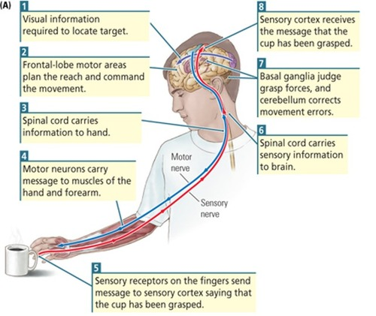
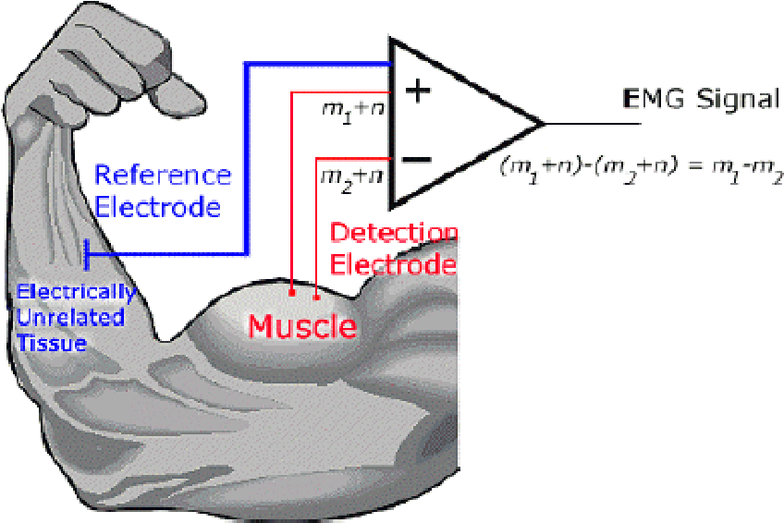
Background
Muscle activity occurs at frequencies between 20 and 500 Hz, and can be read from the skin surfaces as voltages between 50 µV and 10 mV ^{[9]}
Fig 4. Left: Diagram of human neuromuscular control, Right: Electrical principle of sEMG sensing
(figures reproduced from [10,11])

Slide 22
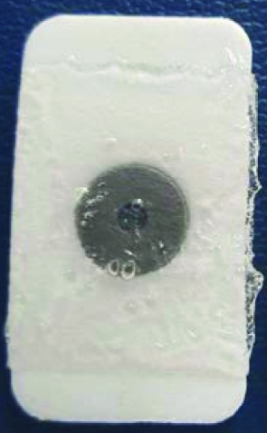
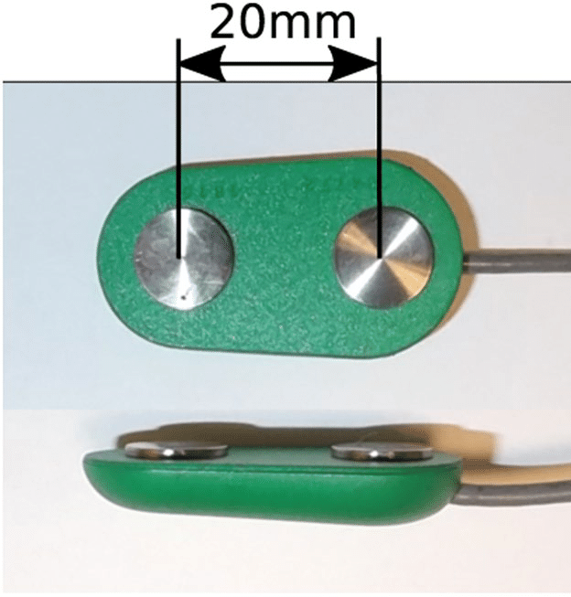
Background
sEMG Electrodes are commonly comprised of:
Exposed conductive pad composed of silver-silver chloride (Ag-AgCl) <= 10 cm² in area ^{[8]}
Clusters of conductive pads may be up to 20mm apart
Applicable/removable polymeric adhesive
Usually around 1 in² contact area ^{[8]}
Additionally, analog and digital filters (ie. RC band pass filtering, and amplification, as well as subject- and state-dependent normalization) are frequently employed to condition sEMG signals.
Fig 5. Common sEMG electrode construction, [8,12]

